Slide 1
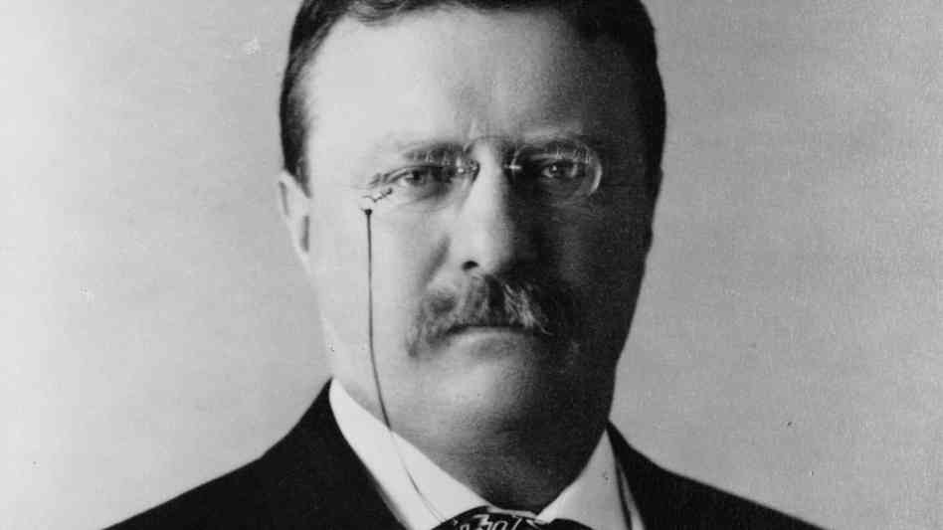
Progressive Movement
1890’s – 1910’s

Slide 2
Gilded Age to Progressive Era

Slide 3
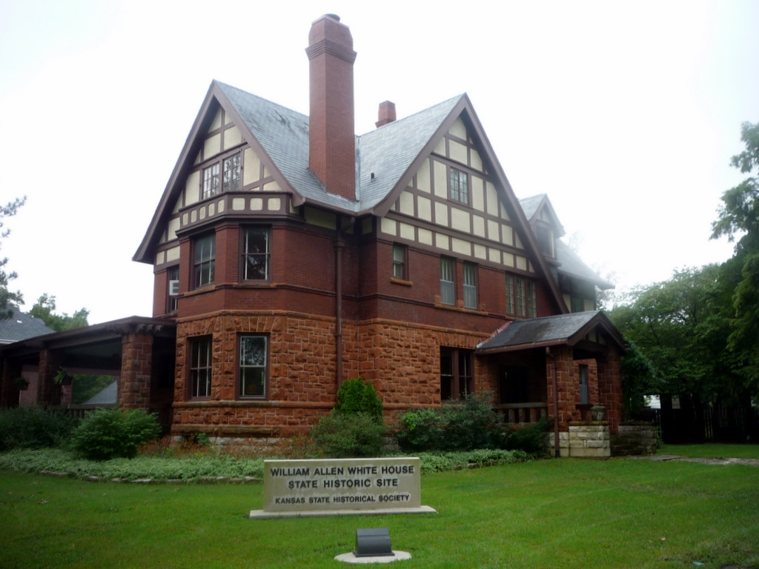
Progressive Mission
Goal: Help Those Who Cannot Help Themselves
Goal: Advance Society; Move Forward
Both Democrats and Republicans were progressives

Slide 4
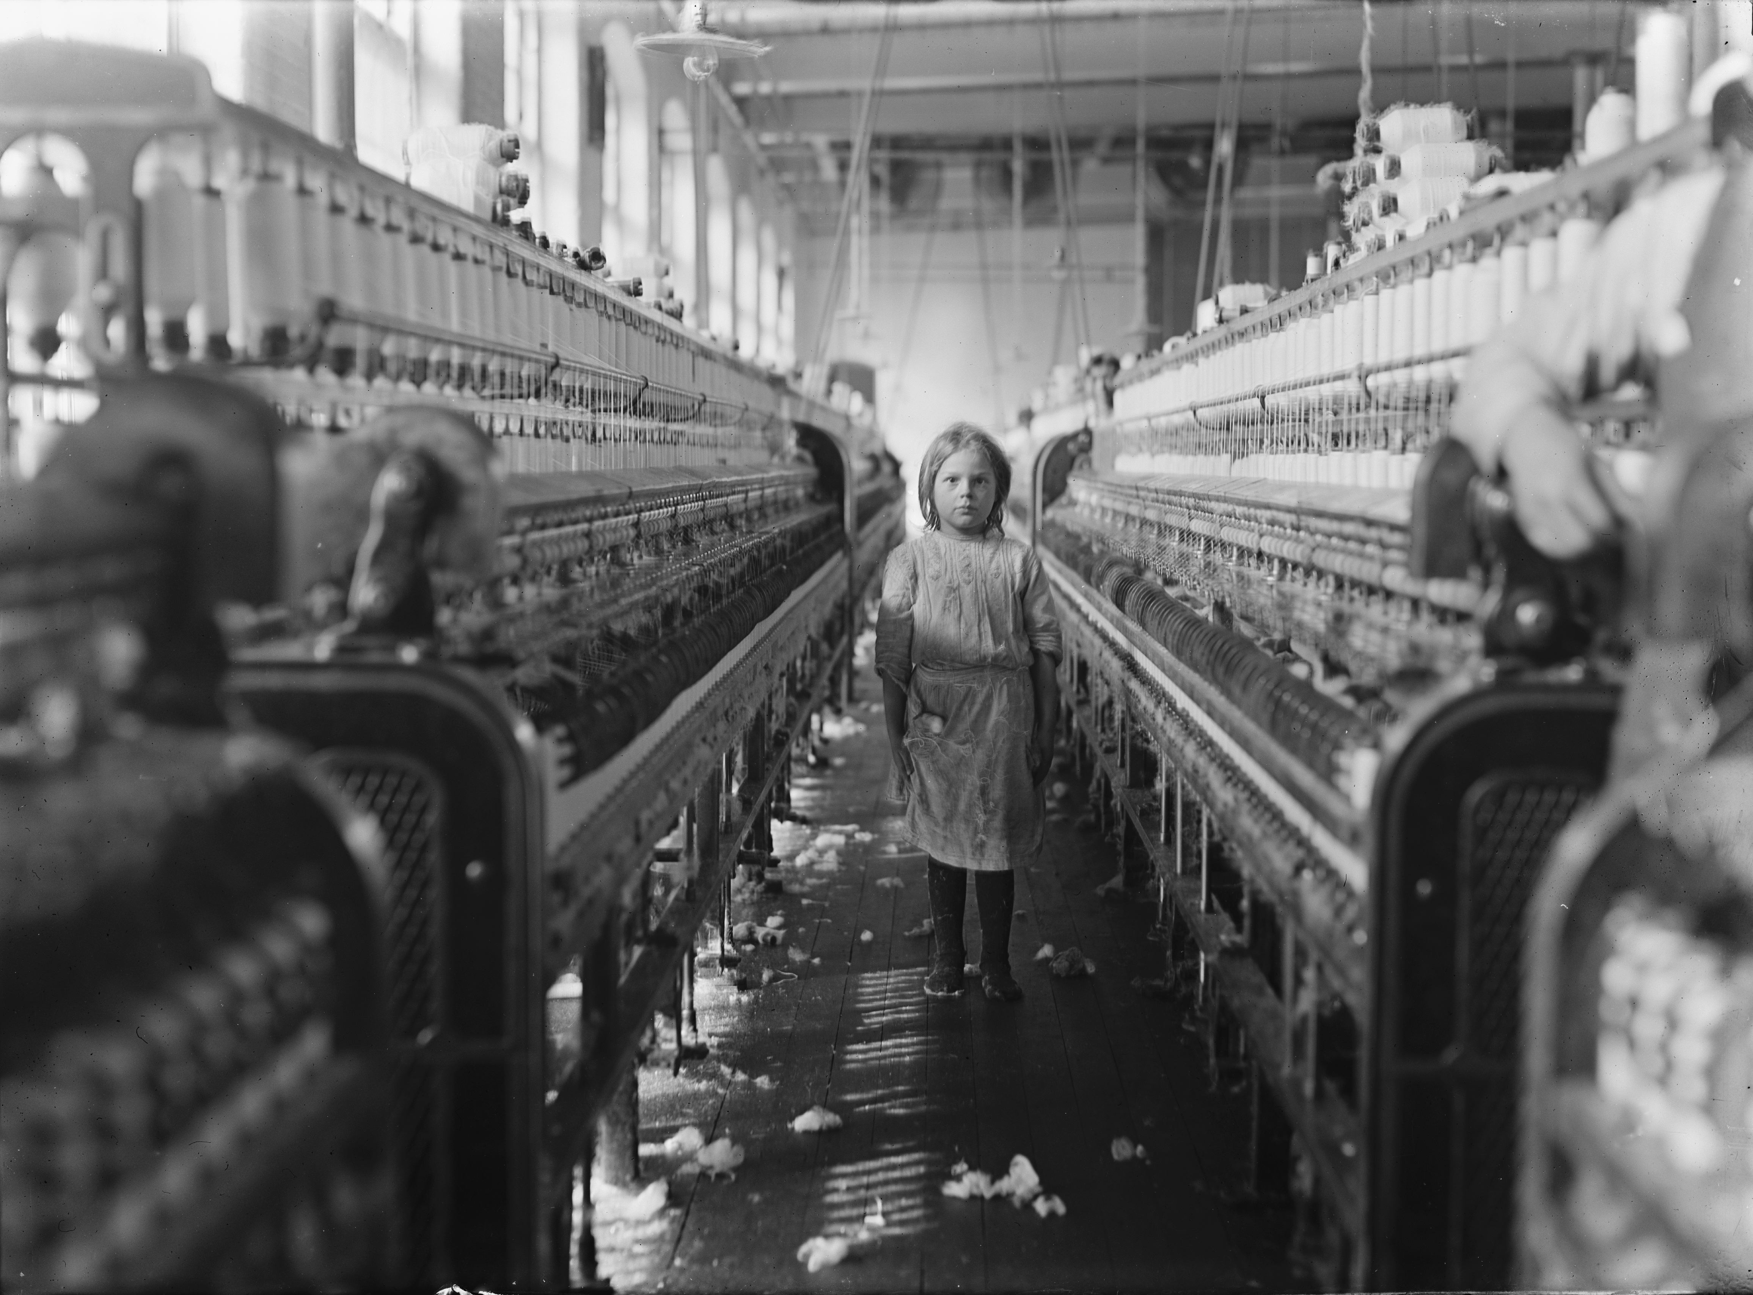
Progressive Reforms
Recall of Elected Officials
Initiatives and Referendums
Child Labor Laws

Slide 5

Progressive Reforms
Requiring Truth in Advertising
Establishing Public Utilities
Guaranteeing Bank Deposits

Slide 6
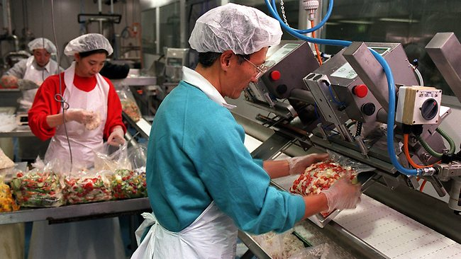
Progressive Reforms
Food Safety Standards
Public Health Standards

